Slide 1
Flight Performance Analysis & Delay Insights
Data – Driven Decision Making for Airlines and Airports
By Rohan Ratan

Slide 2
Project Overview
OBJECTIVE :
To analyze flight data for delay patterns cancellation reason, and on-time performance (OTP) – enabling stakeholders to improve operational efficiency.
KEY QUESTIONS :
What are the main causes of delays and cancellations?
Which airlines and airports perform best or worst?
How do performance trends change over time?

Slide 3
Methodology
Data Source : Flights dataset with timestamps , airlines, airports and delay reasons
Steps:
Data cleaning (PostgreSQL)
Removed nulls, converted data types, and joined tables
KPI calculation
Total Flights, OTP rate, AVG Delay, Cancellation Rate.
Visualization (tableau)
Interactive dashboards with filters and trend lines.

Slide 4
Data Cleaning & Preparation
Actions Taken:
Handled missing values (e.g., delays, cancellation reasons)
Converted data types: time → interval, text → varchar
Created Flights_cleaned table.
Joined with airline and airport data for analysis.
SQL Functions Used:
EXTRACT(), CASE WHEN, COALESCE(), AVG(), ROUND(), GROUP BY

Slide 5
KEY KPIs
KPI | DEFINATIONS | INSIGHTS
Total Flights | Count of all flights | 5.8 M
OTP Rate | % of flights arriving ≤ 15 mins delay | 87 % OTP achieved
AVG Delay | Mean arrival delay (mins) | ~13 min
Cancellation Rate | % of cancelled flights | 2.3 %

Slide 6
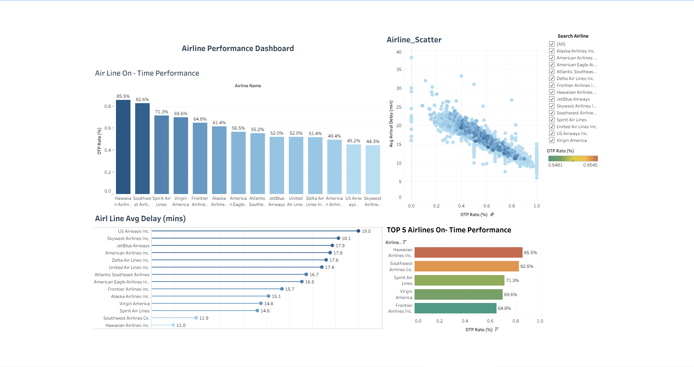
Airline Performance Dashboard
Graphs Used :
Bar Chart : OTP rate by Airline
Lollipop Chart : AVG Delay by Airline (mins)
Scatter plot : OTP vs AVG delay
Bar Chart : Top 5 Airlines By OTP

Slide 7
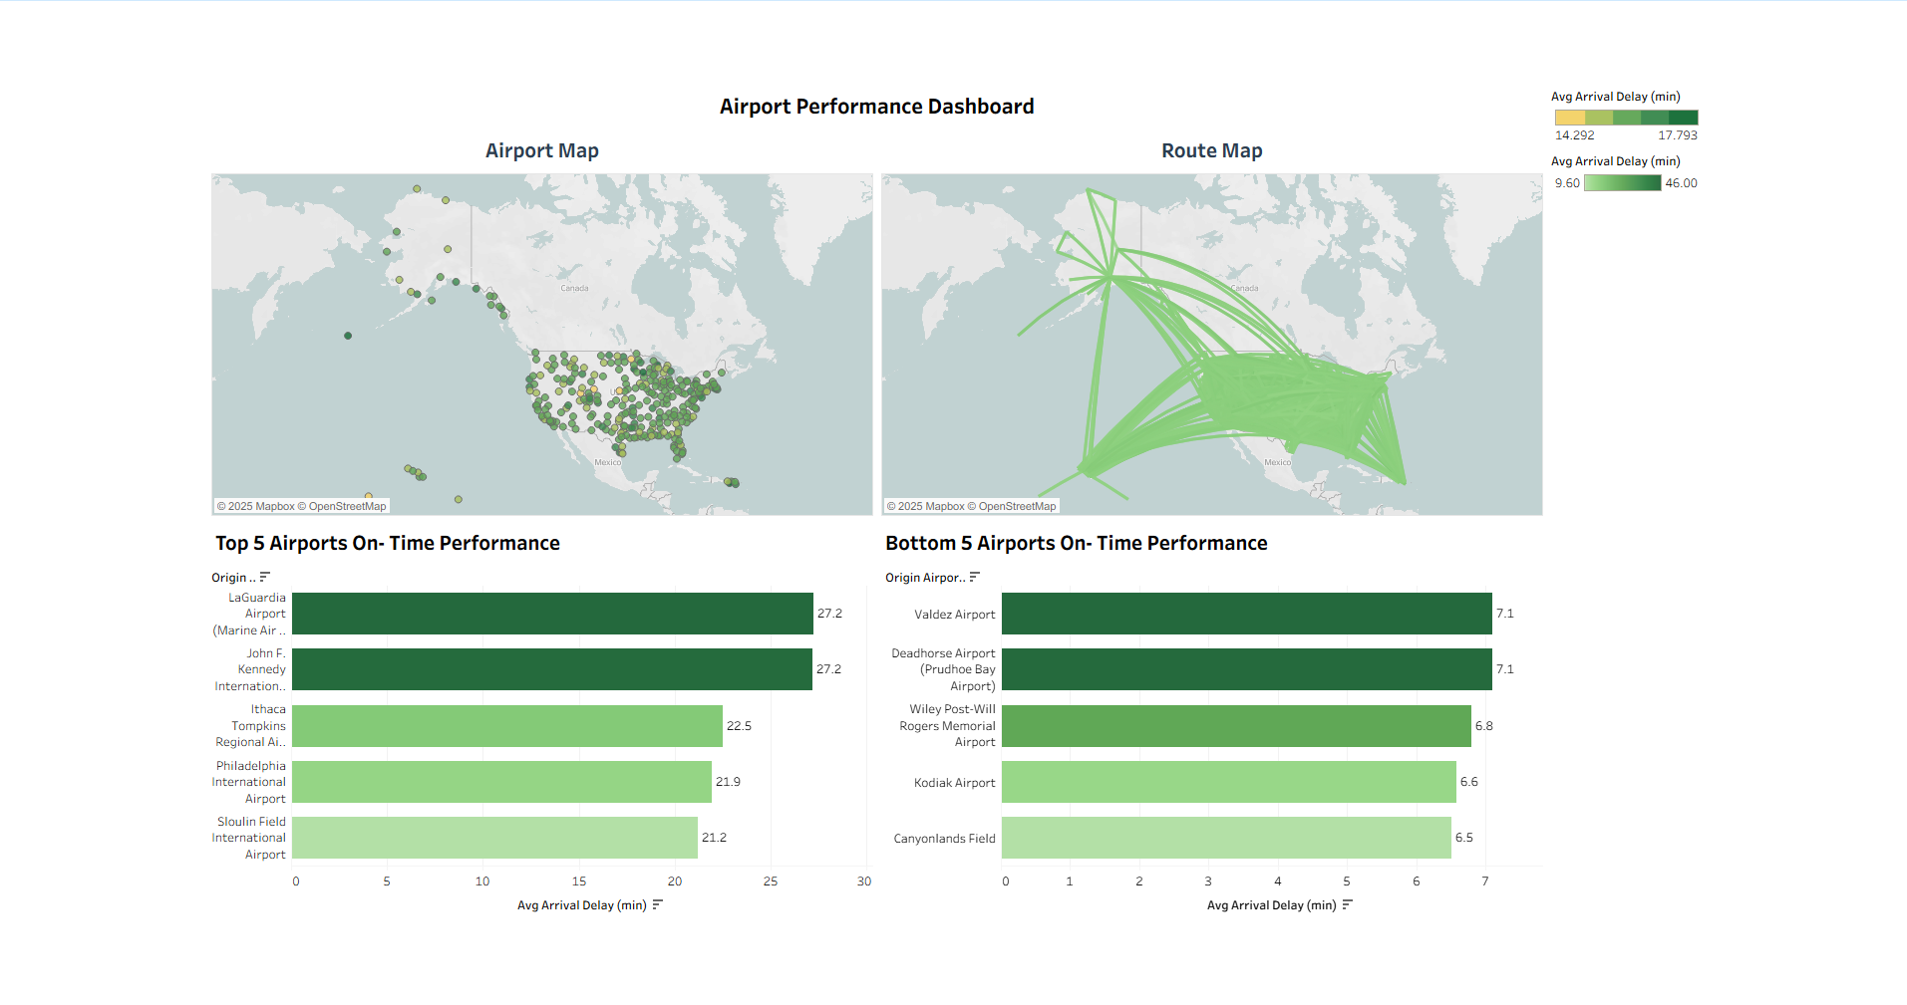
Airport Performance Dashboard
Graphs Used :
Map Chart : Airport map & Route Map
Bar Chart : Top & Bottom 5 Airports (OTP)
Insights :
Airport – wise , smaller regional Airports outperform high – Traffic hubs.
Top 5 Airlines consistently maintain OTP > 75 %.

Slide 8
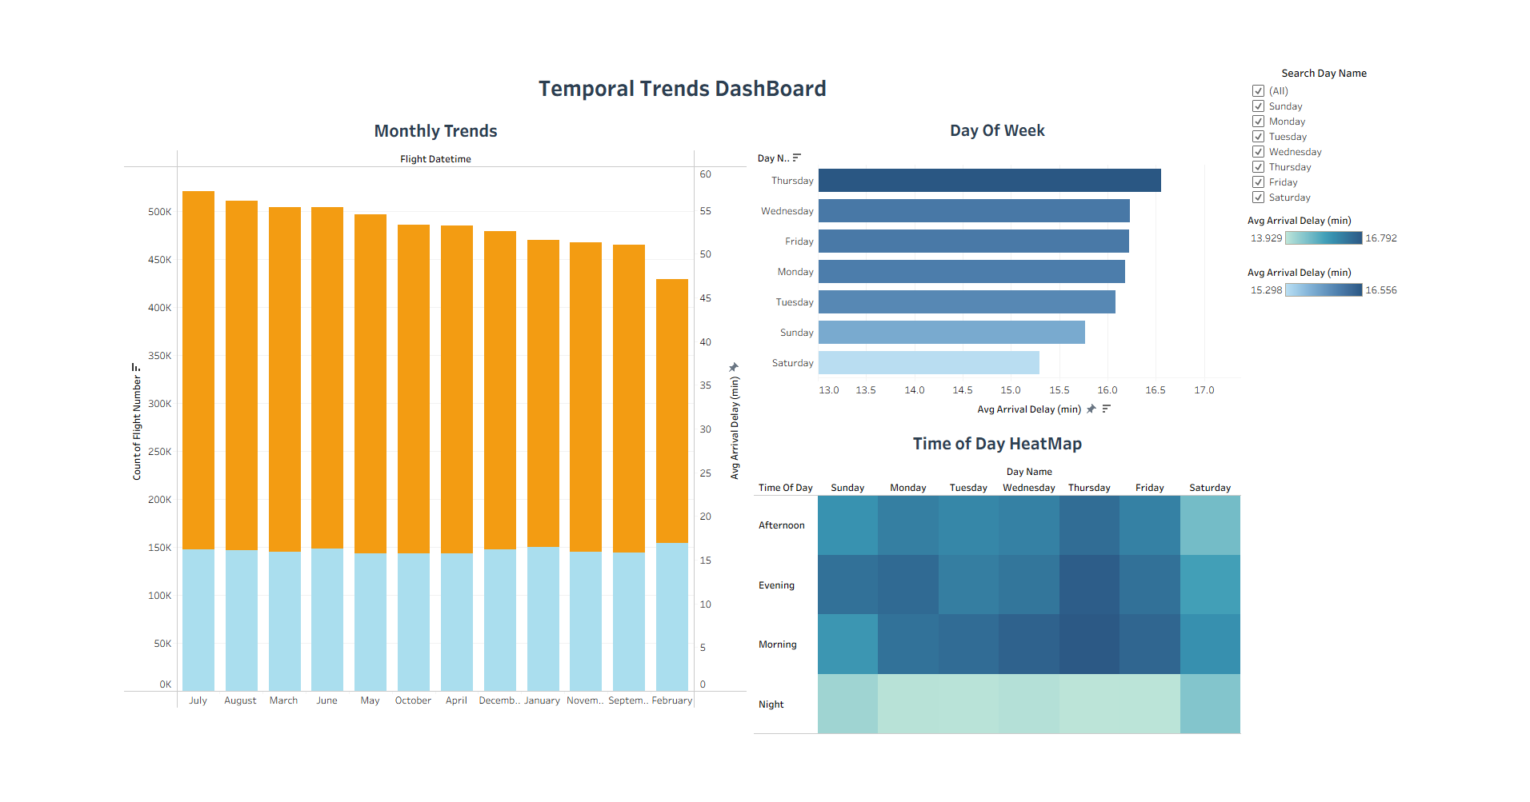
Temporal Trends Dashboard
Graphs Used :
Bar Graph : Monthly Trends &
Day of Week by Arrival delay
Heat Map : Time of Day by Arrival Delay

Slide 9
Interactive Dashboard Overview
Dashboard Pages :
Overview – KPI’s
Airline Performance
Airport Performance ( Map)
Temporal Trends
Filters / Slicers :
Airlines
Aiports
Month / Weekdays

Slide 10
Actionable Recommendations
Optimize flight scheduling – adjust turnaround time for high – delay airlines.
Improve weather handling systems – better forecasting & contingency plans.
Resource planning – allocate more staff during peak weekdays.
Airport collaborations – Coordinate with top – performing airports for best practices.

Slide 11
Conclusion
Summary :
Data revealed Strong seasonality and operational patterns.
Airlines & airports can make data – backed improvements.
Tableau dashboard allows real – time performance monitoring.
Limitations :
Missing Data in smaller airports.
Assumed consistent reporting

Slide 12
Tools & skills demonstrated
SQL ( PostgreSQL) : Data cleaning , KPI Calculation , EDA.
Tableau : Dashboard Creation, Interactivity , KPI Cards.
Data Storytelling : Insight Communication for business use.

Slide 13
Thank You “Turing flight data into actionable insights”
By - Rohan Ratan
Email - rohanratan300@gmail.com
LinkedIn - https://www.linkedin.com/in/rohan-ratan/

